Slide 1
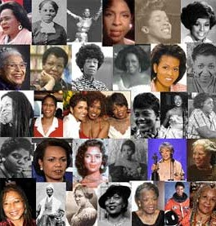

In honor of Black History Month...
Kha Creation, honoring black women who helped create a better world for the times in which they lived as well as for future generations.
Here is a 10 questions challenge for you:

Slide 2

QUESTION #1
Who was the dancer, singer, actor, fundraiser, author, and poet who read a specially-composed poem at President Bill Clinton's inauguration in 1993?
Ruth Jean Simmons
Maya Angelou
Alma Woodsey Thomas
Delorez Florence “Flo-Jo”

Slide 3
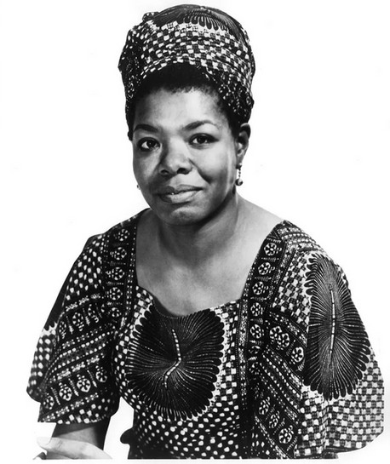
Ans:
Maya Angelou was the dancer, singer, actor, fundraiser, author, and poet who read a specially-composed poem at President Bill Clinton's inauguration in 1993.

Slide 4
QUESTION #2
Who was the first black female newspaper publisher and editor in North America (in Ontario, Canada), and the first black woman to enroll in law school ( Howard University)?
Mary Ann Shadd Cary
Griffith Joyner
Harriet Tubman
Ella Jane Fitzgerald

Slide 5
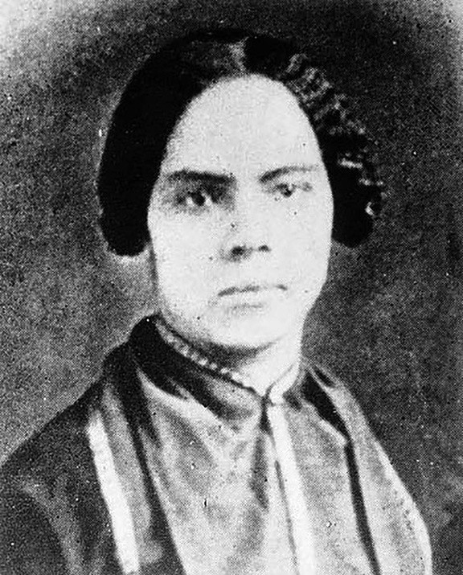
Ans:
Mary Ann Shadd Cary was the first black female newspaper publisher and editor in North America (in Ontario, Canada), and the first black woman to enroll in law school (Howard University).

Slide 6
QUESTION #3
Who was the first black Congresswoman, beginning in 1968; and who in 1972 ran for President and won 151 delegates at the Democratic Convention?
Dorothy Height
Lena Horne
Shirley Chisholm
Zora Neale Hurston

Slide 7
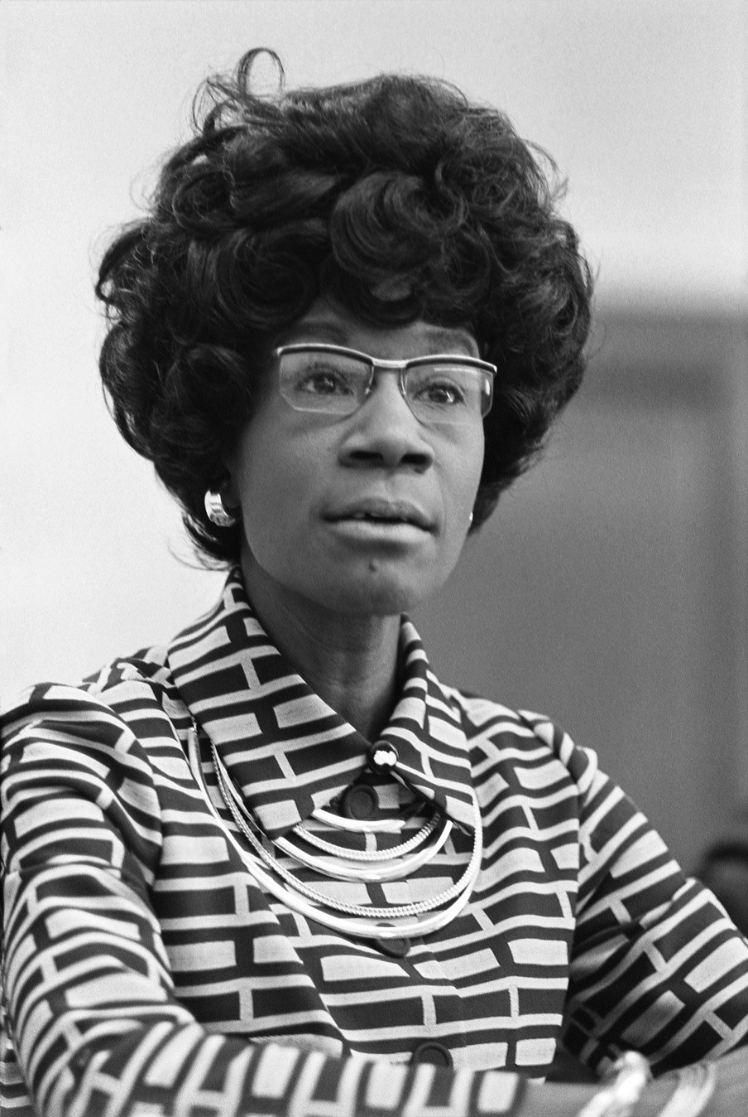
Ans:
Shirley Chisholm was the first black Congresswoman, beginning in 1968; and who in 1972 ran for President and won 151 delegates at the Democratic Convention.

Slide 8
QUESTION #4
Who was the first black woman to win a tennis championship at Wimbledon and the
U.S. Open?
Althea Gibson
Wilma Glodean Rudolph
Marian Anderson
Alice Ball

Slide 9
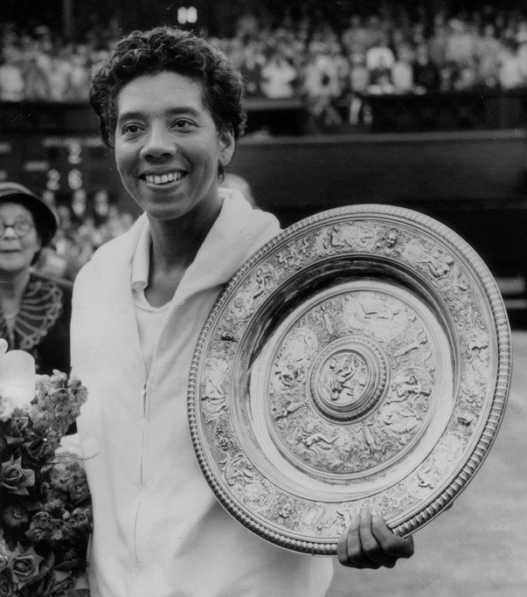
Ans:
Althea Gibson was the first black woman to win a tennis championship at Wimbledon and the U.S. Open.

Slide 10
QUESTION #5
Who was the first woman bank president in America?
Bessie Coleman
Mary Jane McLeod Bethune
Daisy Lee May Bates
Maggie Lena Walker

Slide 11
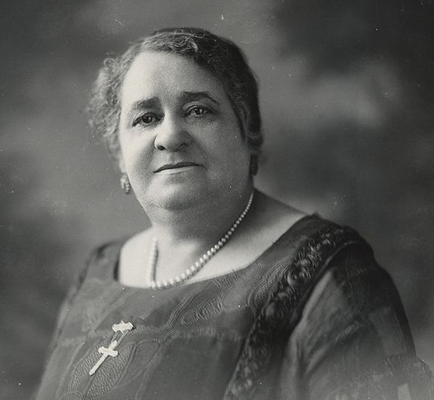
Ans:
Maggie Lena Walker was the first woman bank president in America.

Slide 12
QUESTION #6
Who was the first black woman in the world to earn a pilot's license, and was a barnstorming aviator who performed daredevil tricks?
Johnnetta Cole
Biddy Mason
Bessie Coleman
Pauli Murray

Slide 13
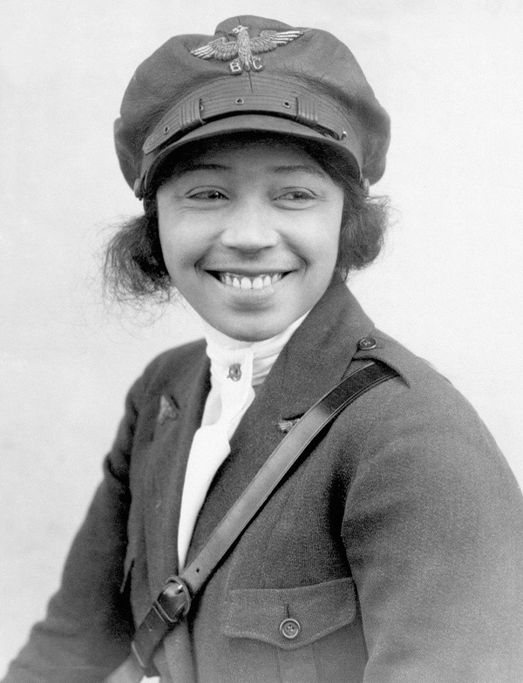
Ans:
Bessie Coleman was the first black woman in the world to earn a pilot's license and was a barnstorming aviator who performed daredevil tricks.

Slide 14
QUESTION #7
Who was a nightclub and cabaret idol of Paris in the 1920s and a freedom fighter during World War II?
Josephine Baker
Thelma "Butterfly" McQueen
Ella Jane Fitzgerald
Anna Cooper

Slide 15
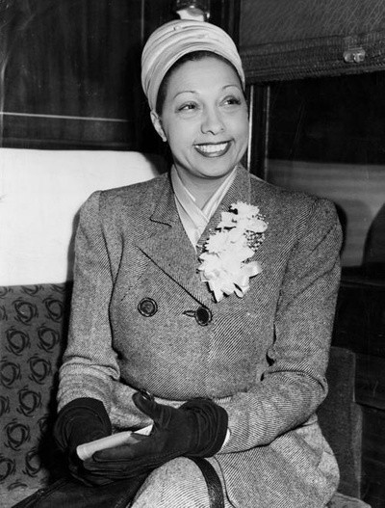
Ans:
Josephine Baker was a nightclub and cabaret idol of Paris in the 1920s and a freedom fighter during World War II.

Slide 16
QUESTION #8
Who was the first black concert pianist to play with a European orchestra in 1904?
Charlotte Ray
Hazel Harrison
Jacqueline "Jackie" Joyner Kersee
Maria Louise Baldwin

Slide 17
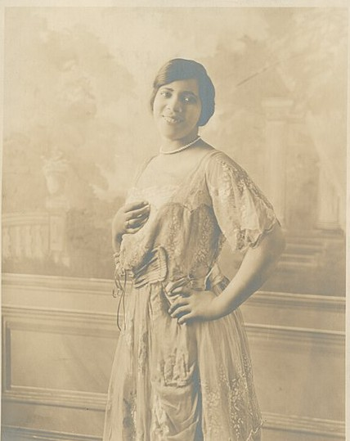
Ans:
Hazel Harrison was the first black concert pianist to play with a European orchestra in 1904.

Slide 18
QUESTION #9
Who became a self-made millionaire philanthropist after creating a hair product sold house-to-house, and later held what may be the first national meeting of businesswomen in the U.S. in 1917?
Madam C.J. Walker
Mary Jane Patterson
Nannie Burroughs
Sojourner Truth

Slide 19
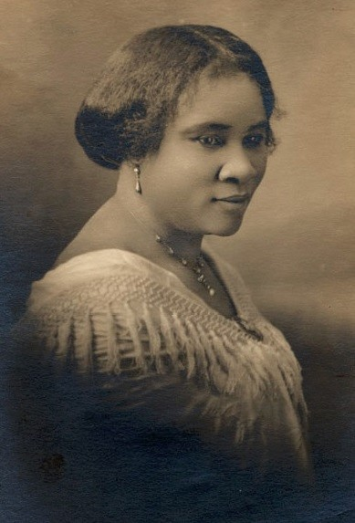
Ans:
Madam C.J. Walker became a self-made millionaire philanthropist after creating a hair product sold house-to- house and later held what may be the first national meeting of businesswomen in the U.S. in 1917.

Slide 20
QUESTION #10
Who was a conductor on the Underground Railroad and secured the freedom of at least 300 enslaved people, making 19 trips into the South over 10 years, and served as a spy and scout for the Union Army?
Lorraine Hansberry
Patricia Roberts Harris
Margaret Abigail Walker Alexander
Harriet Tubman

Slide 21
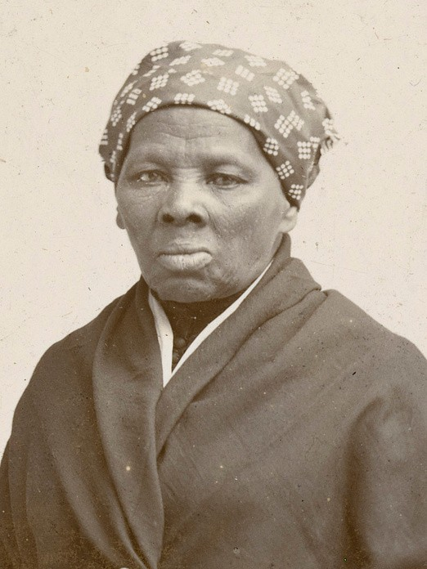
Ans:
Harriet Tubman was a conductor on the Underground Railroad and secured the freedom of at least 300 enslaved people, making 19 trips into the South over 10 years, and served as a spy and scout for the Union Army.

Slide 22
Hope you enjoyed the quiz!

